Slide 1
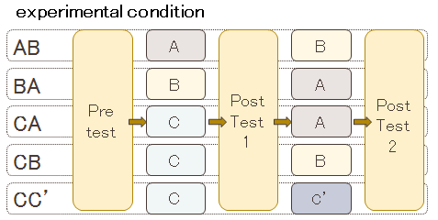
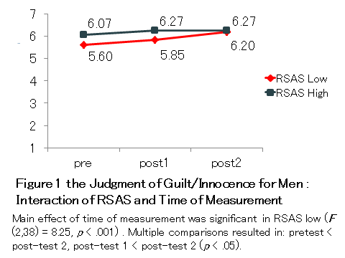
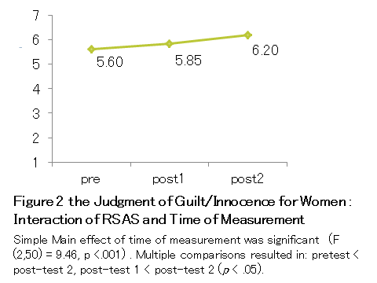
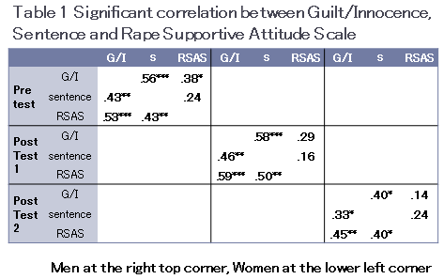
GENDER DIFFERENCE OF EFFECTS
OF RAPE SUPPORTIVE ATTITUDE
toward THE JUDGMENT OF GUILT OR INNOCENCE
IN A MOCK JURY TRIAL EXPERIMENT
N. Kitakaze¹ , T.Ito² , T. Inoue³
¹ National Center for Global Health and Medicine, Tokyo, Japan ² Wako University, Tokyo, Japan ³ Meiji Gakuin University, Tokyo, Japan
Objectives:
In Japan, citizen judge system came into force on May 21, 2009, under which citizen judge selected from the general public participate in a criminal trial for serious cases. Citizen judge, consisting of six people, with three professional judges, determine whether the defendant is guilty or not and what sentence if guilty. (the ministry of justice HP) It is important to choose the saiban-in who have a non-judgmental attitude for the defendant and complainant. But in rape cases, the previous research on judgment of date rape, factors influencing judgment of date rape in decision makers indicated the significance of gender (Pollard, 1992; Kitakaze et al., 2011) and rape supportive attitude (Lottes, 1998; Kitakaze, 2011).
The purpose of this study is that to examine the effects of rape supportive attitude and educational intervention about rape on the judgment of rape, an experiment was conducted by using scenarios of mock jury trials.
Methods:
 | Rape Supported Attitude Scale (Lottes, 1998)
1 | Women enjoy sexual violence
2 | Women are responsible for rape prevention
3 | Sex rather than power is the primary motivation for rape
4 | Rape happens only to certain kinds of women
5 | A women is less desirable after she has been raped
6 | Women falsely report many rape claims
7 | Rape is justified in some situations
Participants 70 students at two colleges (35 males, 35 females), with an average age of 22.26 years (SD = 2.73) for the males, and 21.96 years (SD = 2.07) for the females.
investigation procedure Between January and August 2011, a scenario experiment took place in a regular classroom within the university, lasting about one hour. The participants followed the instructions on a piece of paper, and after answering a pre-test, they read the teaching materials 1. After a break, then they completed post-test 1, and read the teaching materials 2. After a second break, they answered post-test 2.
Thus the experiment was of a three-factor mixed design, with the gender of the participant × instructional contents (AB, BA, CA, CB, CC’) × time of measurement (pre-test, post-test 1, post-test 2).
Questionnaire Content (1) Explanation of experiment content; (2) juridical knowledge; (3) overview of criminal court trial; (4) judgment of guilt/innocence (1 innocence with certainty – 7 guilt with certainty) and period of sentence (1.5 - 20years in prison) ; (5) rape supportive attitude scale (RSAS) ; (6) demographic factors; (7) presentation of educational material 1; (8) sort/listing; (9) post-test 1 (same as (3)-(5)); (10) presentation of educational material 2; (11) sort/listing; (12) post-test 2 (same as (3)-(5)).
 | educational material contents
A | rape supportive attitudes developed by women’s associations
B | the notebooks of rape victim’s about their experiences
C | stress management (control materials)
C’ | the achievements of the Hepburns, who introduced a system of romanization in Japan (control materials)
Results:
Three-factor analysis of variance on the judgment of guilt/innocence with independent variables of five types, x RSAS (high, low) x time of measurement (3) revealed that, for men, interaction of RSAS and time of measurement was statistically significant. For women, simple main effect of time of measurement was significant.
Conclusions:
The effects of educational interventions about rape on the judgment of guilt/innocence were different between male and female. Men with high rape supportive attitude tend to judge a rape offender guilty, while women’s judgment was independent from rape supportive attitude.
References
Lottes, I. (1991). Belief systems: Sexuality and rape. Journal of Psychology & Human Sexuality, 4, 37-59.
Gray, J. M. (2006). Rape myth beliefs and prejudiced instructions: Effects on decisions of guilt in a case of date rape. Legal and Criminological Psychology. 11, 75-80.

